Slide 1
4. Sorting Algorithms:
Insertion Sort
Notes:
Algorithm Analysis and Sorting
12/10/2004
NCI BSHSS/E2 SD3

Slide 2
4.1 The Insertion Sort Problem
Try recalling how you sort a deck of cards.
  You start from the beginning
  traverse through the cards
  if you find cards misplaced by precedence you remove them and insert them back into the right position.
  Eventually what you finally have is a sorted deck of cards
The same idea is applied in the Insertion Sort algorithm !
Dr. Cristina Muntean (NCI)
Notes:
Algorithm Analysis and Sorting
12/10/2004
NCI BSHSS/E2 SD3

Slide 3
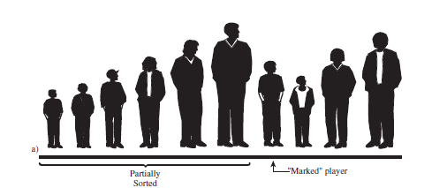
4.1 The Insertion Sort Problem
Consider your football players lined up in random order
You want to sort them based on their height
Easier to understand insertion sort if we begin in the middle of the process, when the team is half sorted.
  Consider a marker somewhere in the middle of the line
  The players to the left of the marker are partially sorted. They are sorted among themselves; each one is taller than the person to his left.
    Are these players in their final position?
Source: “Data Structures and Algorithms in Java”, by Robert Lafore, SAMS Ed.
Dr. Cristina Muntean (NCI)
Notes:
Algorithm Analysis and Sorting
12/10/2004
NCI BSHSS/E2 SD3

Slide 4
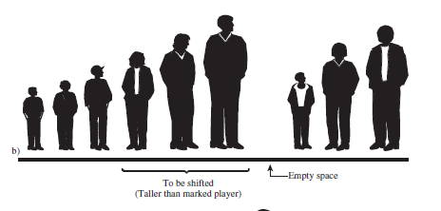

4.1 The Insertion Sort Problem
Take and insert the marked player in the appropriate place in the (partially) sorted group.
  We’ll need to shift some of the sorted players to the right to make room.
  To provide a space for this shift, we take the marked player out of line.
Source: “Data Structures and Algorithms in Java”, by Robert Lafore, SAMS Ed.
Dr. Cristina Muntean (NCI)
Notes:
Algorithm Analysis and Sorting
12/10/2004
NCI BSHSS/E2 SD3

Slide 5
4.1 The Insertion Sort Problem
Shift the sorted players to make room for the marked player.
  The tallest sorted player moves into the marked player’s spot,
  the next-tallest player into the tallest player’s spot, and so on.
When does this shifting process stop?
Source: “Data Structures and Algorithms in Java”, by Robert Lafore, SAMS Ed.
Dr. Cristina Muntean (NCI)
Notes:
Algorithm Analysis and Sorting
12/10/2004
NCI BSHSS/E2 SD3

Slide 6
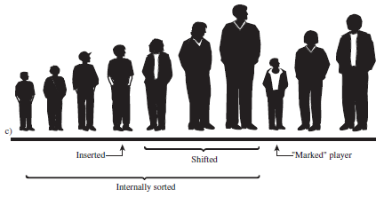
4.1 The Insertion Sort Problem
When does this shifting process stop?
  At each position you shift another player to the right,
  but you also compare the marked player with the player about to be shifted.
The shifting process stops when you’ve shifted the last player that’s taller than the marked player.
  The last shift leaves a space where to insert the marked player
Source: “Data Structures and Algorithms in Java”, by Robert Lafore, SAMS Ed.
Dr. Cristina Muntean (NCI)
Notes:
Algorithm Analysis and Sorting
12/10/2004
NCI BSHSS/E2 SD3

Slide 7
4.1 The Insertion Sort Problem
Now the partially sorted group has one extra player, and the unsorted group has one player less.
The marker is moved one space to the right, on the next player
Repeat the previous process
New marker
Source: “Data Structures and Algorithms in Java”, by Robert Lafore, SAMS Ed.
Dr. Cristina Muntean (NCI)
Notes:
Algorithm Analysis and Sorting
12/10/2004
NCI BSHSS/E2 SD3

Slide 8
4.2 Insertion Sort Mechanism
Start the iteration with the second position that is considered the key element ( marked player)
In i^{th} iteration:
  read i^{th} value in the collection => key
  repeatedly swap value with the one to its left if it is smaller => move the key to the left.
  Stop when you reach a value smaller than the key or when you reach the beginning of the colection
Dr. Cristina Muntean (NCI)
Notes:
Algorithm Analysis and Sorting
12/10/2004
NCI BSHSS/E2 SD3

Slide 9
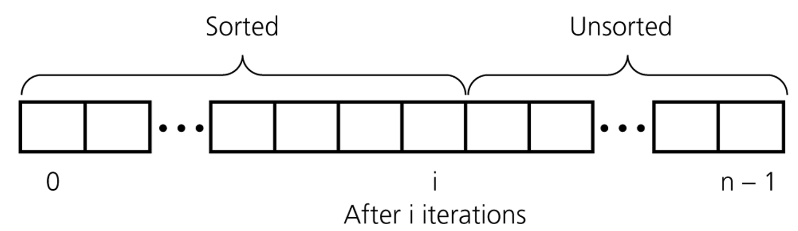
4.2 Insertion Sort Mechanism
Description of the sorting algorithm
An insertion sort algorithm divides the collection (array) into two regions
After i^{th} iteration, the array is partially sorted
  positions 0 through i contain elements sorted in ascending order.
  postions i+1 through n-1 contain unsorted elements
Dr. Cristina Muntean (NCI)
Notes:
Algorithm Analysis and Sorting
12/10/2004
NCI BSHSS/E2 SD3
n

Slide 10
4.2 Insertion Sort Mechanism
Exercise
Suppose you have an collection of numbers, represented as:
    {26, 4, 7, 10, 1};
and you want to sort the collection in ascending order
Illustrate, iteration by iteration how elements are moved
Dr. Cristina Muntean (NCI)
Notes:
Algorithm Analysis and Sorting
12/10/2004
NCI BSHSS/E2 SD3
n

Slide 11
4.3 Insertion Sort Algorithm – Pseudo-Code
for i = 1 up to i< numOfElements, i++
{
keyelement = elementAt(i);
pos = i; //position of the key element
while pos > 0 and elementAt(pos-1) > keyelement
{
elementAt(pos) = elementAt(pos–1);
pos = pos -1;
} //end while loop
elementAt(pos) = keyelement;
}
Keyelement
8 6 10 3 1 2 5 4 pass i=1 (Original array)
6 8 10 3 1 2 5 4 pass i=2
6 8 10 3 1 2 5 4 pass i=3
3 6 8 10 1 2 5 4 pass i=4
1 3 6 8 10 2 5 4 pass i=5
1 2 3 6 8 10 5 4 pass i=6
1 2 3 5 6 8 10 4 pass i=7
1 2 3 4 5 6 8 10 Final array (sorted)
Dr. Cristina Muntean (NCI)
Notes:
Algorithm Analysis and Sorting
12/10/2004
NCI BSHSS/E2 SD3

Slide 12
4.3 Insertion Sort Algorithm – Pseudo-Code
Examine the array (previous slide) as it sorted step by step
Note that each pass represents the status of the array after the completion of the inner for loop ( except for pass 1! )
Pass 1 is only to show the state of the unsorted array before applying the algorithm
For example:
  Pass 1: remove 6 from its current position and "insert" it back to the top
  Pass 3: remove 3 from its current position and insert it at the top.
  Pass 5: 2 is moved from position 5 to position 1 since its < (6,8,10) but > 1.
Within n (size of the array) steps all elements will be moved to the proper position.
Dr. Cristina Muntean (NCI)
Notes:
Algorithm Analysis and Sorting
12/10/2004
NCI BSHSS/E2 SD3

Slide 13
4.4 Complexity of the Insertion Sort Algorithm
for i = 1 up to i< numOfElements, i++
{
keyelement = elementAt(i);
pos = i; //position of the key element
while pos > 0 and elementAt(pos-1) > keyelement
{
elementAt(pos) = elementAt(pos–1);
pos = pos -1;
} //end while loop
elementAt(pos) = keyelement;
}
keyelement = elementAt(i); and pos = i have complexity: O(1)
WHILE loop has complexity M*O(1) = O(M), M – number of elements to be shifted.
  The worst case input is an array sorted in reverse order
  every iteration of the while loop will compare and shift the entire partially sorted side of the array => O(N)
elementAt(pos) = keyelement; has complexity: O(1)
FOR loop has complexity: N* ((O(1)+O(1)+O(N)+O(1) ) = O(N*N)
Dr. Cristina Muntean (NCI)

Slide 14
4.4 Complexity of the Insertion Sort Algorithm
What is the efficiency of the insertion sort?
For data that is already sorted or almost sorted, the insertion sort does much better than the bubble sort
  When data is in order, the condition in the while loop is never true, so it becomes a
  simple statement in the FOR loop, which executes N-1 times. In
    this case the algorithm runs in O(N) time.
for data arranged in inverse sorted order, every possible comparison and shift is carried out
  so the insertion sort runs no faster than the bubble sort.
Dr. Cristina Muntean (NCI)

